Slide 1
Binomial Distribution

Slide 2
NBA 2021 Season
Your favorite team has made it to the final seconds of the 2021 NBA finals. Your team is behind by 2 and your favorite players (a 90% free throw shooter) has three free throws. What is the probability that your team takes the lead? Tie the game?

Slide 3
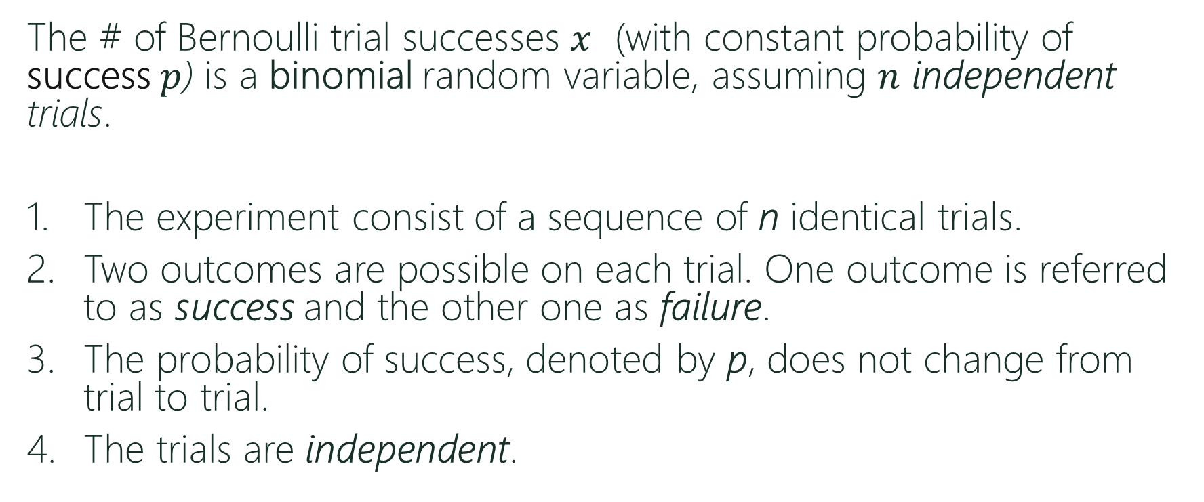
Binomial Distribution
The # of Bernoulli trial successes $x$ (with constant probability of success $p$) is a binomial random variable, assuming $n$ independent trials.
The experiment consist of a sequence of n identical trials.
Two outcomes are possible on each trial. One outcome is referred to as success and the other one as failure.
The probability of success, denoted by p, does not change from trial to trial.
The trials are independent.

Slide 4
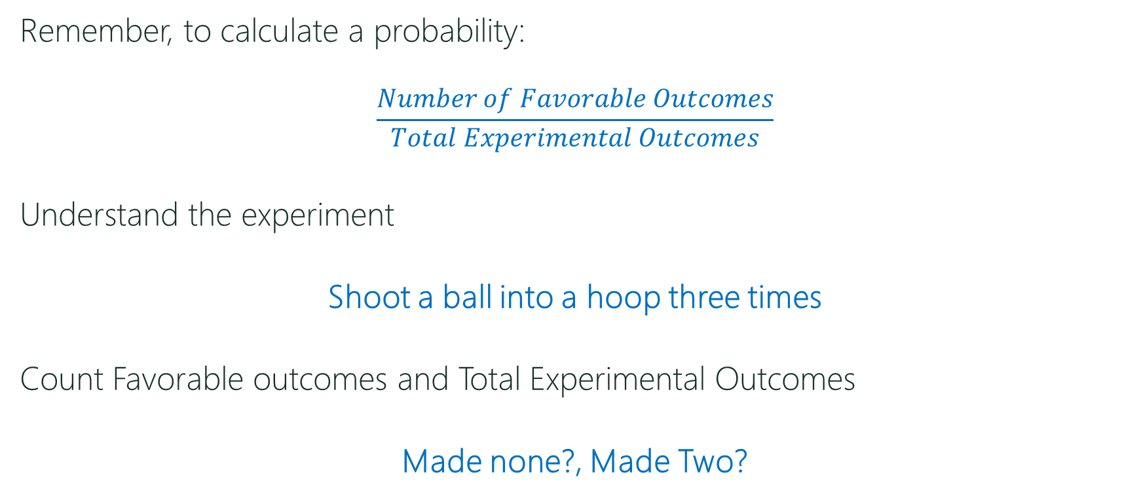
Back to Basketball
Remember, to calculate a probability:
$$\frac{Number of Favorable Outcomes}{Total Experimental Outcomes}$$
Understand the experiment
Shoot a ball into a hoop three times
Count Favorable outcomes and Total Experimental Outcomes
Made none?, Made Two?

Slide 5
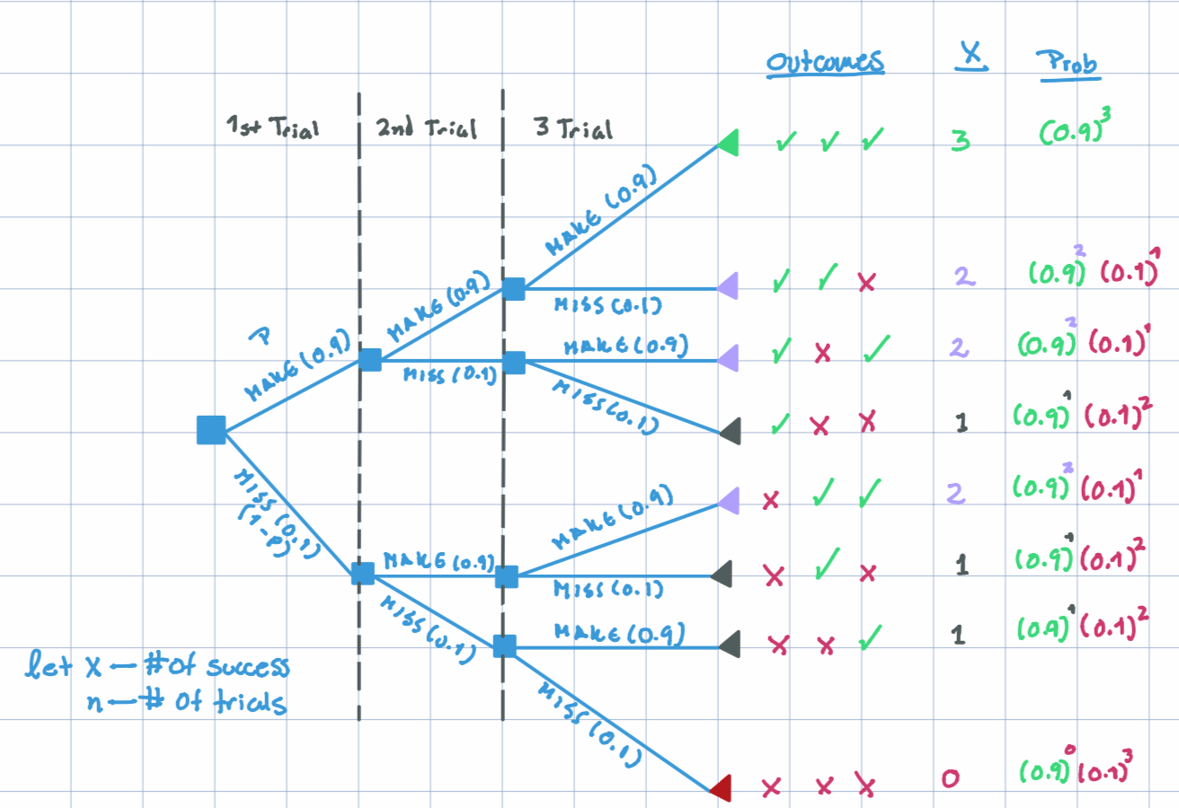
Back to Basketball

Slide 6
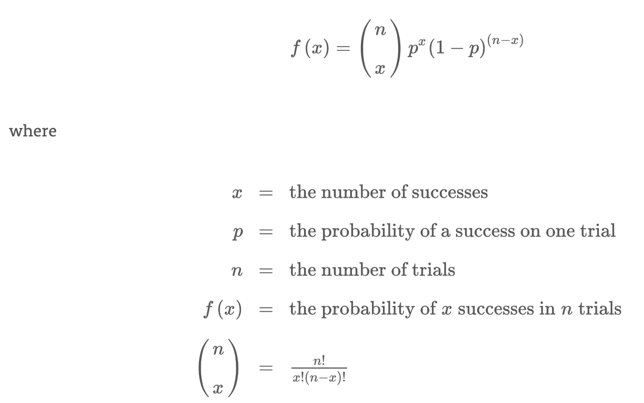
Binomial P.M.F. (discrete density)
The probability mass function is given by:

Slide 7
Binomial Example in R
Example: Suppose that completed units produced by a production process are of good quality with probability 0.83 and that the process produces 5 units per shift.
What is the probability that exactly 2 are of poor quality?
What is the probability that at least 1 unit is of poor quality?
What is the Expected Value and Variance?

Slide 8


Recall
Average or Expected Value:
Variance:

Slide 9
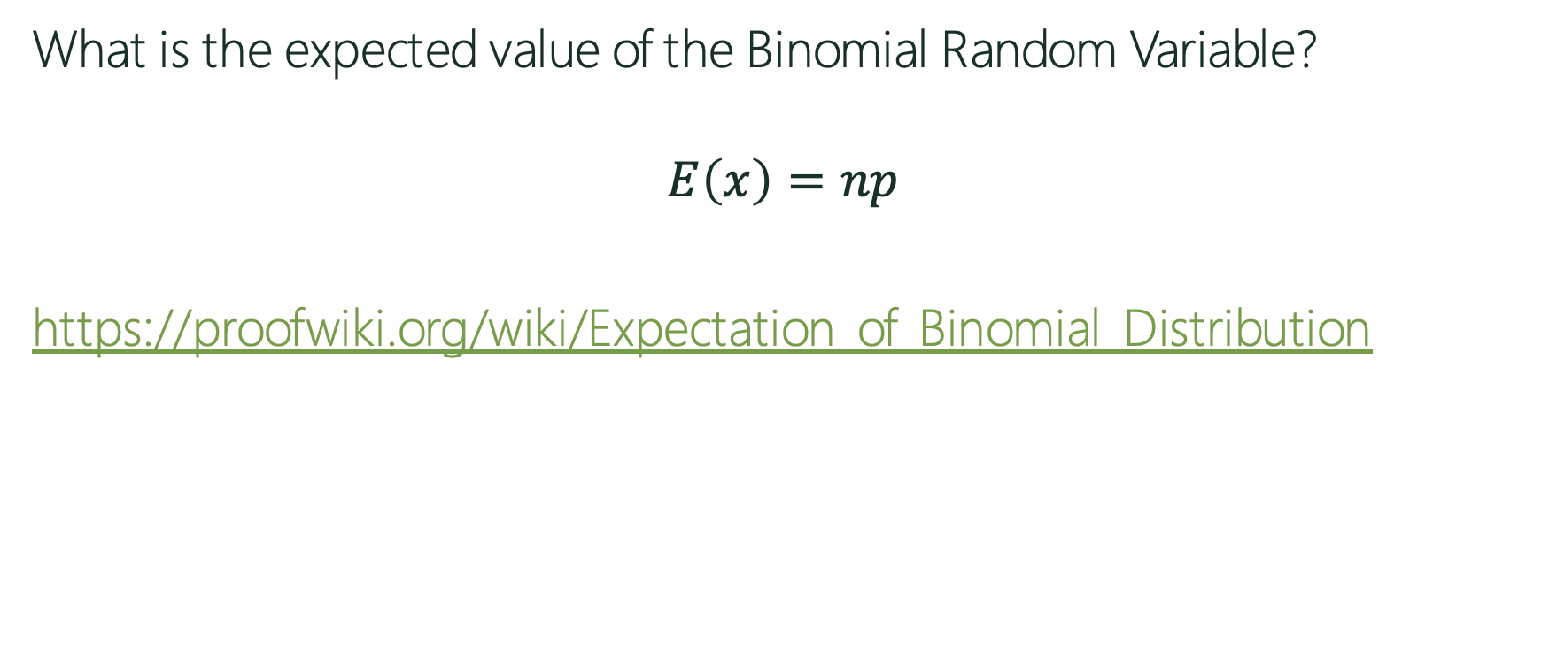
Binomial Expected Value
What is the expected value of the Binomial Random Variable?
$$E\left(x\right)=np$$
https://proofwiki.org/wiki/Expectation_of_Binomial_Distribution

Slide 10
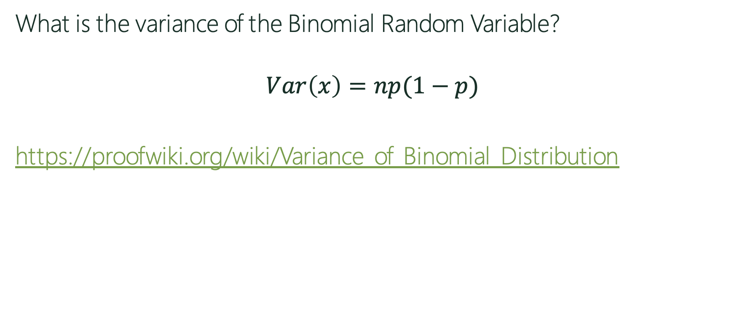
Binomial Variance
What is the variance of the Binomial Random Variable?
$$Var\left(x\right)=np(1−p)$$
https://proofwiki.org/wiki/Variance_of_Binomial_Distribution

Slide 11
Binomial Expected Value
Task: Simulate the basketball example in R 10,000 times.
Create a histogram of your simulation.
Calculate the expected value. Are you close to np?
Calculate the variance. Are you close to np(1-p)?
Out of the 10,000 times you ran the experiment, how many times did you make only one shot?

